Slide 1



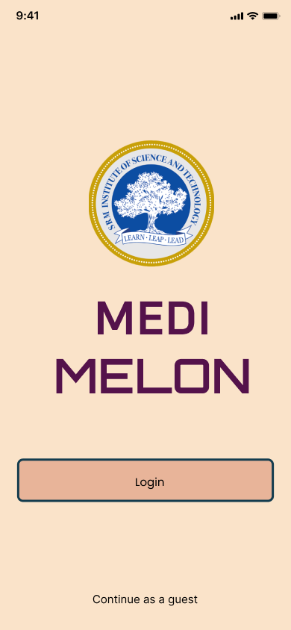
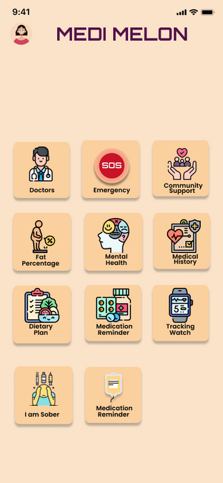
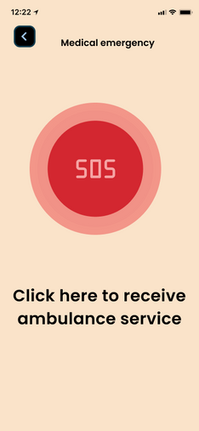
HackTrix’24
Team Name: Watermelon
Members Name:
Bharath R(RA2211047010021)
Vishal Aravinth(RA2211047010024)
Harsith SH(RA2211047010099)
Suggu Varshith Reddy(RA2211047010100)
Abraham X(RA2211047010101)

Slide 2


Introduction
Project Overview
This health app aims to provide comprehensive support for users in various aspects of their well-being, encompassing physical health, mental wellness, and community engagement. It offers a range of features including an SOS function for emergencies, a precise fat percentage tracker using openCV technology, personalized diet plans tailored to Indian cuisine, mental health tools such as stress-relief games and relaxation sessions, and a self-diagnosis tool with recommendations for top doctors and hospitals. Additionally, the app includes resources for trauma therapy, rehabilitation from smoking, drug, and alcohol addiction, management of medical history including prescriptions, sleep pattern tracking, medication reminders, and progress monitoring. Through integration with community support groups and virtual therapy sessions, the app seeks to foster a supportive environment for users to improve their health and well-being.

Slide 3

Target Users and market selection
this app has a target audience of all the adults above the age of 18 who need to reform their physical and mental health along with medical assistance and SOS emergency feature. This app also has a feature which helps users to quit their smoking and drinking addiction and also helps provides distracting games which helps them to quit smoking and lightens the mood.
. Specific Needs Seekers:
Individuals struggling with specific challenges such as:
Weight management
Stress and anxiety
Sleep problems
Smoking or alcohol cessation
Desire targeted support and resources for their specific needs.
May be open to community support from others facing similar challenges.

Slide 4


Problems
Many people struggle to prioritize both their physical and mental well-being due to:
Information overload
Lack of personalized guidance
Difficulty managing multiple resources
Stigma surrounding mental health and addiction:
Explain
Conflicting wellness advice online creates confusion. People crave personalized plans for diet, exercise, mental health, and addiction recovery, but struggle with generic options and juggling multiple resources. The stigma surrounding these issues adds another hurdle. Our app tackles this by offering a holistic, user-friendly platform for a sustainable path to well-being.

Slide 5


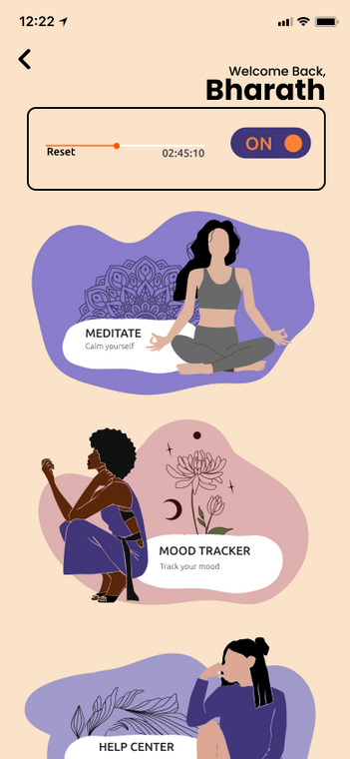
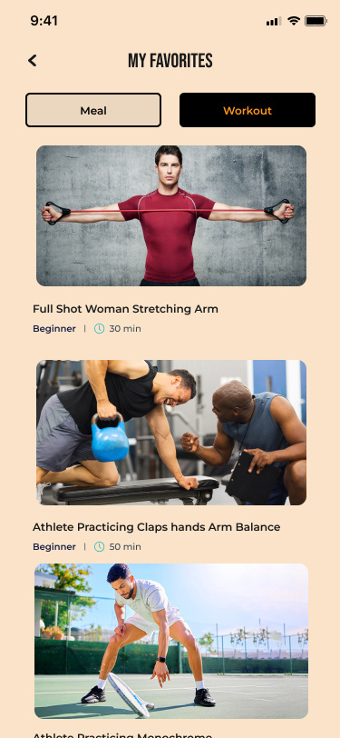

Proposed solution
Solution
Solution
Personalized Guidance: Wellspring uses an initial assessment and machine learning to create customized plans for diet, exercise routines, and mental health exercises.
Holistic Approach: The app integrates these plans seamlessly, allowing users to track progress across all aspects of well-being in one place.
Supportive Community: The app fosters a safe and anonymous community forum for users to connect, share experiences, and find motivation.
Addiction Recovery Tools: Wellspring provides tools and trackers specifically designed to aid users quitting smoking and alcohol, including progress visualizations and relapse prevention strategies.
Self-Assessment & Goal Setting: Users complete an initial assessment to identify areas of concern (stress, anxiety, sleep issues) and establish personalized goals (improved focus, better sleep hygiene).
CBT Techniques: Learn and practice evidence-based cognitive behavioral therapy (CBT) techniques to challenge negative thought patterns and develop healthier coping mechanisms.
Emergency Resources: Provide easily accessible hotlines and resources for crisis intervention and mental health professionals.
Progress Tracking: Track progress over time through mood charts, streaks of completed exercises, and goal achievement milestones.

Slide 6
Solution 2
Challenges and Key Learning (Technical challenges, Solutions & workaround, Key learnings)
Finding balance: Addressing both physical and mental well-being requires a nuanced approach. You'll need to ensure your app offers effective tools for both aspects without neglecting one for the other.
Content credibility: The information you provide needs to be reliable and evidence-based. Consider collaborating with healthcare professionals or certified fitness instructors for content creation.
Personalization: People have diverse needs and preferences. The app should offer customization options for workout routines, meditation styles, and goal setting to cater to a broad user base.
Engagement: Keeping users motivated and coming back for more is crucial. Think about features like progress tracking, challenges, and rewards to promote long-term engagement.
User-centered design: Prioritize user research and testing throughout the development process. This will help ensure your app addresses real user needs and offers a positive user experience.
Collaboration is key: Consider partnering with health and fitness experts to ensure the app offers effective and safe guidance.
Start small, scale smart: It's better to launch with a solid foundation and essential features than an overwhelming set that might be buggy. You can always add functionalities based on user feedback.

Slide 7
Future work
App Store Launch: Launch your app on relevant app stores (iOS and/or Android). Prepare marketing materials and a launch strategy to gain initial users.
User Feedback and Analytics: Continuously monitor user engagement and feedback through app analytics and user surveys.
Content Updates: Regularly update the app with new workouts, meditations, and educational content to keep users engaged.
New Feature Development: Based on user feedback and market trends, consider developing new features to enhance the app's functionality and value proposition.
Explain
Additional Considerations:
Gamification: Consider implementing gamification elements like badges, challenges, and leaderboards to boost user motivation and engagement.
Community Building: Explore ways to build a supportive community within the app where users can connect, share experiences, and motivate each other.
Accessibility: Ensure your app is accessible for users with disabilities by incorporating features like screen readers and alternative text descriptions.
This is a flexible framework, you can adjust the timelines and specific activities based on your resources and project scope. Remember, the key is to prioritize user needs, focus on high-quality content and user experience, and continuously iterate based on user feedback.

Slide 8
⁠Business Model and Monetization
(Business model canvas, Monetization, Estimated costs) (Potential features, plans for scaling)
Explain
In-App Purchases:
Offer the core app for free but allow users to purchase individual workouts, meditation sessions, or premium content packs (e.g., yoga routines, sleep meditations).
Consider offering consumable in-app purchases, like credits for purchasing individual workouts or meditation sessions.
Partner with fitness studios, yoga instructors, or mental health professionals to offer exclusive content within the app. Users might pay a separate fee to access this premium partner content.
Partner with health insurance companies or wellness organizations to offer the app as a benefit to their members. You could receive a fee per user enrolled through these partnerships.

Slide 9

Conclusion
(Recap & acknowledgments)
Strategy 1
In today's fast-paced world, prioritizing both physical and mental well-being is crucial. Your innovative physical and mental wellness app has the potential to empower individuals to take charge of their health and happiness. By offering a user-centric approach, this app can become a one-stop shop for fitness routines, mindfulness exercises, and educational content, all designed to cultivate a healthy lifestyle.
The key to success lies in balancing the needs of both the body and mind. Through a combination of engaging workouts, effective meditations, and high-quality educational resources, your app can cater to a broad user base.
Remember, user engagement is paramount. Regular content updates, gamified elements, and a supportive community can all contribute to keeping users motivated and on their wellness journey.
Finally, a well-defined business model ensures the app's long-term sustainability. By offering a freemium model with premium features, in-app purchases, or strategic partnerships, you can create a value proposition that benefits both users and your business.
With a focus on user experience, evidence-based content, and continuous improvement, your physical and mental wellness app has the potential to make a significant impact on people's lives. Let's strive to create a world where prioritizing well-being is accessible and achievable for everyone.

Slide 10
with their prototype working
PPT should not be more than 10 slides

